Slide 1
SIMPLE PRESENT TENSE
NEGATIVE FORMS

Slide 2
SIMPLE PRESENT TENSE-AFFIRMATIVE FORM
A Quick Review
Daily routine-I wake up at 6 am.
He does yoga every morning.
Regular or
repeated actions- We pay the bills every month.
He goes to market once a week.
Universal truths- The sun rises in the east.
Stars twinkle at night.

Slide 3
General facts- Birds fly in the air.
A cow eats grass.

Slide 4
SIMPLE PRESENT TENSE-NEGATIVE FORM
I He
We She
You + don’t +V1 It + doesn’t +V1
They
Plural nouns Singular nouns

Slide 5
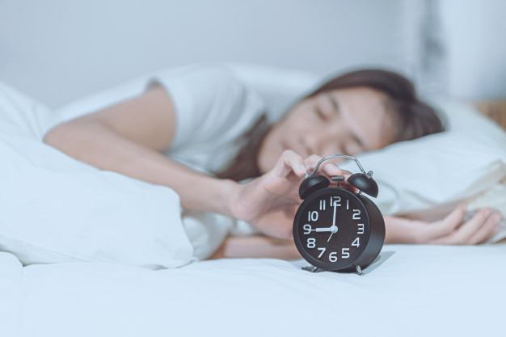
SIMPLE PRESENT NEGATIVE FORMS
Priya wakes up late.
She doesn’t wake up early.

Slide 6
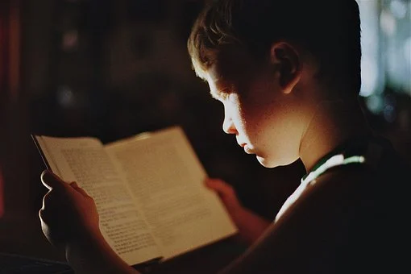
SIMPLE PRESENT –NEGATIVE FORMS
He reads books.
He doesn’t watch TV.

Slide 7

SIMPLE PRESENT –NEGATIVE FORMS
We drink black coffee.
We don’t drink tea.

Slide 8
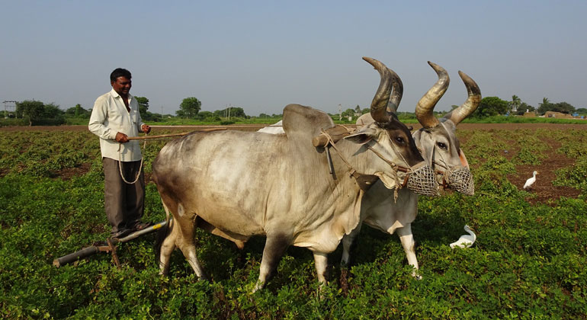
SIMPLE PRESENT –NEGATIVE FORMS
My father lives in the village.
He doesn’t live in the city.

Slide 9
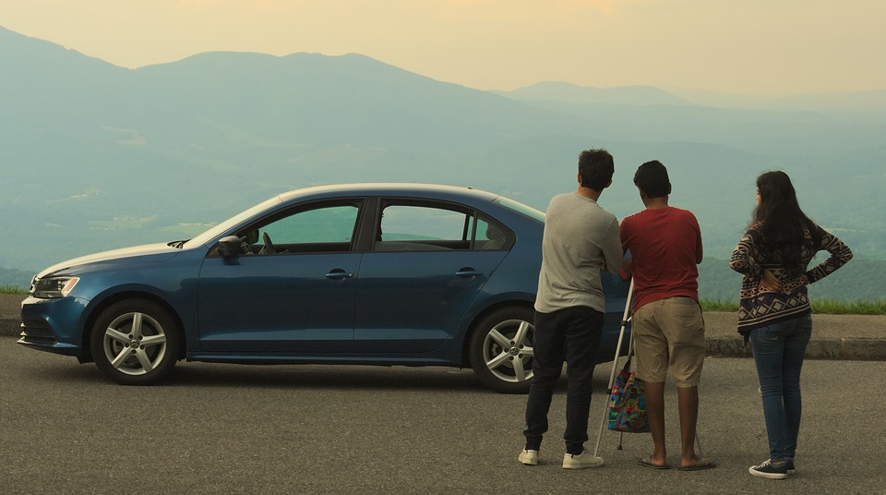
SIMPLE PRESENT –NEGATIVE FORMS
They travel by car.
They don’t travel by bus.

Slide 10
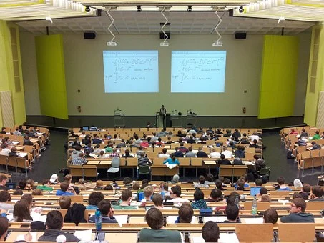
SIMPLE PRESENT –NEGATIVE FORMS
The students attend English classes
three days a week .
They don’t attend English classes every day.

Slide 11

SIMPLE PRESENT –NEGATIVE FORMS
The sun shines during the day.
It doesn’t shine at night.

Slide 12

SIMPLE PRESENT –NEGATIVE FORMS
Honey tastes sweet.
Honey doesn’t taste sour.

Slide 13
SIMPLE PRESENT –NEGATIVE FORMS
She sings well---She doesn’t sing well.
I meet my friends every day.---I don’t meet my friends every day.
My teacher gives homework.---My teacher doesn’t give homework.
We watch movies often.---We don’t watch movies often.
My mother goes to work.---My mother doesn’t go to work.
This clock shows the right time.-This clock doesn’t show the right time.
He eats out very often.---He doesn’t eat out very often.
The company pays its employees well.-The company doesn’t pay its
employees well.

